Slide 1
Demand Side Management for a Campus Infrastructure
Team : Gandhi Rajan , Aswin Natesh, Mohammed Saqib , Badri Narayanan
Internal Guide : Dr. SG Bharathi Dasan
Batch : A6 | Place : In-House

Slide 2
Abstract
We propose a novel optimization algorithm for handling loads using Demand Side Management (DSM). DSM consists of planning, implementing, and monitoring activities of electrical utilities which encourage consumers to modify their level and pattern of electricity usage. Fortunately, DSM focuses only on cost reduction by flattening the load curve, and energy management is not considered. Introducing Fuzzy controlled energy management technique along with existing DSM strategies results in increased sustainability.
Simulations are carried out for a Campus infrastructure, utilizing the existing photo-voltaic array with battery storage. These existing assets are treated as local DC grid, and plays a vital role in managing the overall cost. In addition to this, DSM also encourage consumers to lower energy consumption which leads to a significant drop in emission of harmful gases into the atmosphere thereby helping curtail the global warming process. The bulk proportion of CO2 emissions is from fossil fuel based power plants. Reducing environmental degradation and saving our future generation from this huge complication, reduction of CO2 footprint has also been accounted in our objective function.

Slide 3
Objectives
The proposed project is an alternative to traditional load shedding, fall in system frequency, overall cost effectiveness, and also features reduction of Carbon Footprint. These are discussed in detail below.
Load Shedding - The proposed project is an alternative to traditional load Shedding
Frequency Drop - Sudden fall of system frequency when demand on a power system is greater than the generation.
Cost Effectiveness - Develop efficient utilization strategy for electricity, and encourages consumers to help flattening their load curve.
Carbon Footprint – Reducing the consumption, inturn reduces the Co2 Emission's for Fossil Fuel based power generation units.

Slide 4
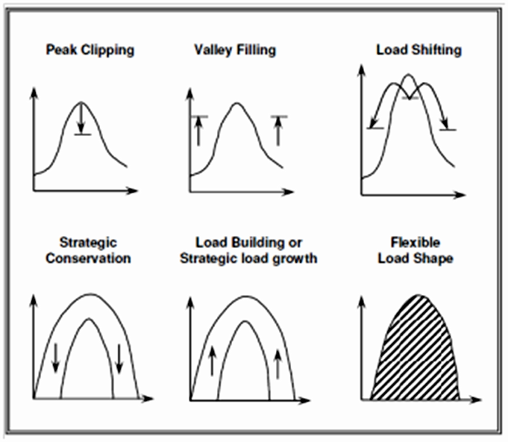
DSM Strategy & Approach
Adopted Strategy – Load Shifting
Solution through Evolutionary Algorithm – GA

Slide 5
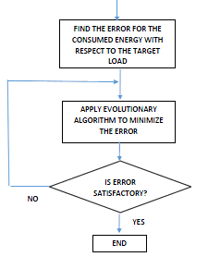
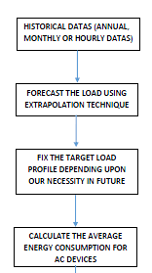
Block Diagram
Input Data to DSM Controller

Slide 6
The Current Progress
Treating various stages of the issues, we are addressing these through Matlab Simulation Environment
Stages completed
Problem Formulation – DMS
Genetic Algorithm Tool – Single Objective

Slide 7
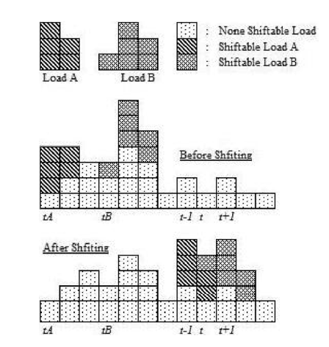
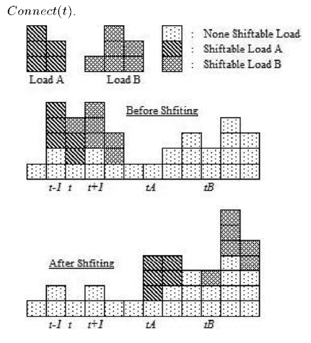
Problem Formulation
Disconnecting Loads Connecting Loads

Slide 8
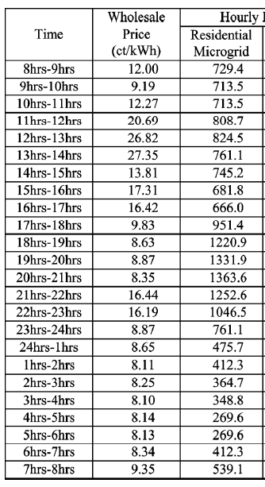
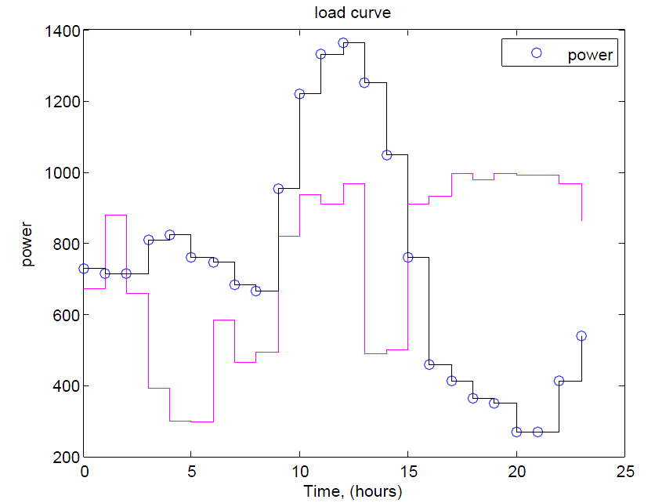
Load Profile - Assumption

Slide 9
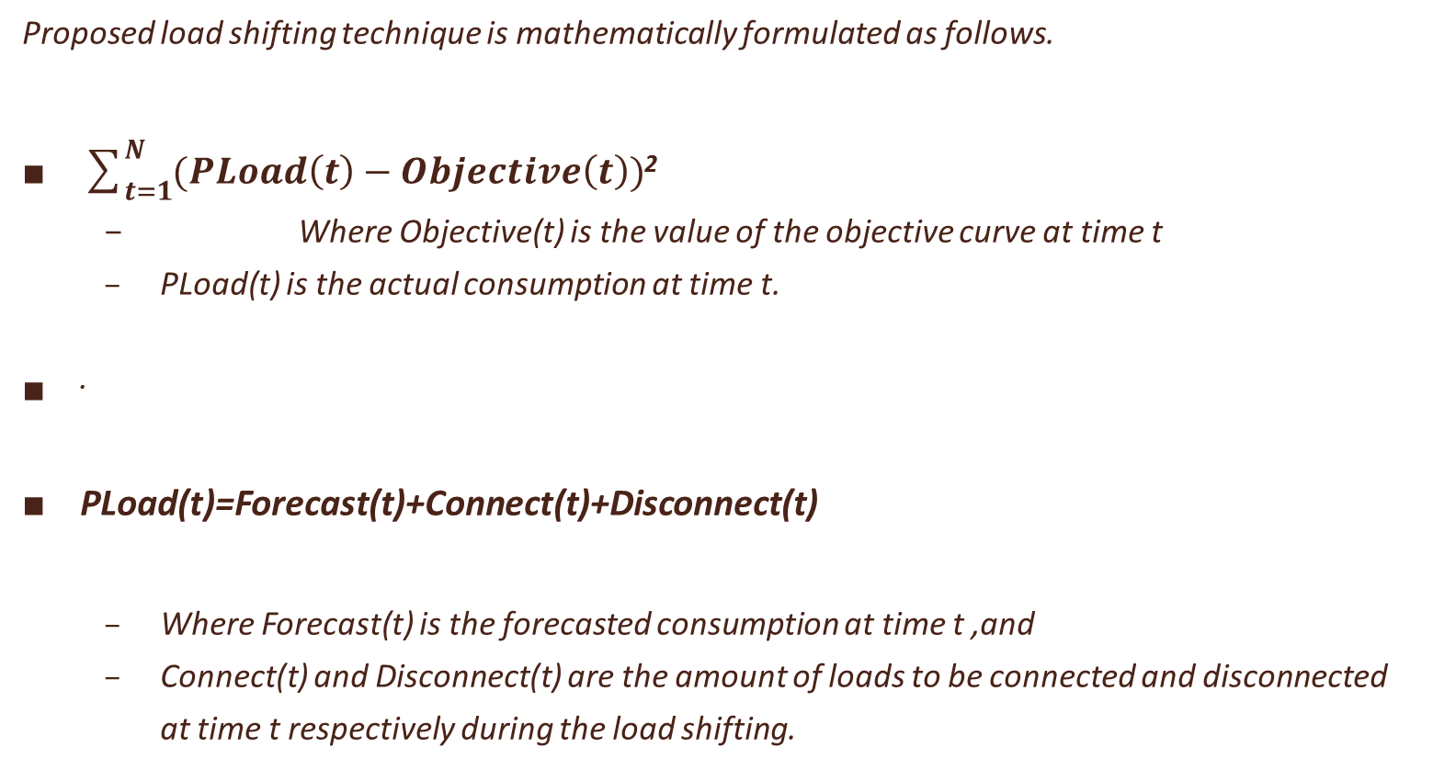
Proposed load shifting technique is mathematically formulated as follows.
$\sum_{t=1}^{N}{(PLoad\left(t\right)−Objective\left(t\right))}$²
Where Objective(t) is the value of the objective curve at time t
PLoad(t) is the actual consumption at time t.
.
PLoad(t)=Forecast(t)+Connect(t)+Disconnect(t)
Where Forecast(t) is the forecasted consumption at time t ,and
Connect(t) and Disconnect(t) are the amount of loads to be connected and disconnected
at time t respectively during the load shifting.

Slide 10
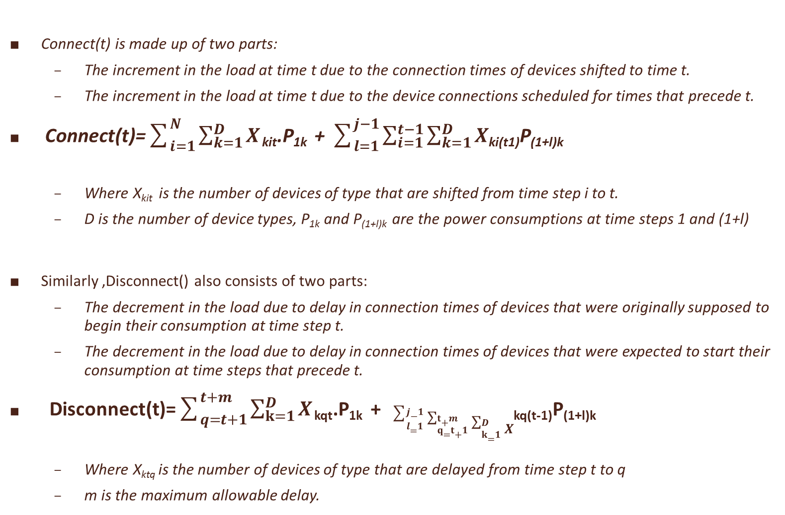
Connect(t) is made up of two parts:
The increment in the load at time t due to the connection times of devices shifted to time t.
The increment in the load at time t due to the device connections scheduled for times that precede t.
Connect(t)=$\sum_{i=1}^{N}{\sum_{k=1}^{D}{X}}$ _{kit}.P_{1k} + $\sum_{l=1}^{j−1}{\sum_{i=1}^{t−1}{\sum_{k=1}^{D}{X}}}$_{ki(t1)}P_{(1+l)k}
Where X_{kit} is the number of devices of type that are shifted from time step i to t.
D is the number of device types, P_{1k} and P_{(1+l)k} are the power consumptions at time steps 1 and (1+l)
Similarly ,Disconnect() also consists of two parts:
The decrement in the load due to delay in connection times of devices that were originally supposed to begin their consumption at time step t.
The decrement in the load due to delay in connection times of devices that were expected to start their consumption at time steps that precede t.
Disconnect(t)=$\sum_{q=t+1}^{t+m}{\sum_{k=1}^{D}{X}}$ _{kqt}.P_{1k} + $\sum_{l=1}^{j−1}{\sum_{q=t+1}^{t+m}{\sum_{k=1}^{D}{X}}}$_{kq(t-1)}P_{(1+l)k}
Where X_{ktq} is the number of devices of type that are delayed from time step t to q
m is the maximum allowable delay.

Slide 11
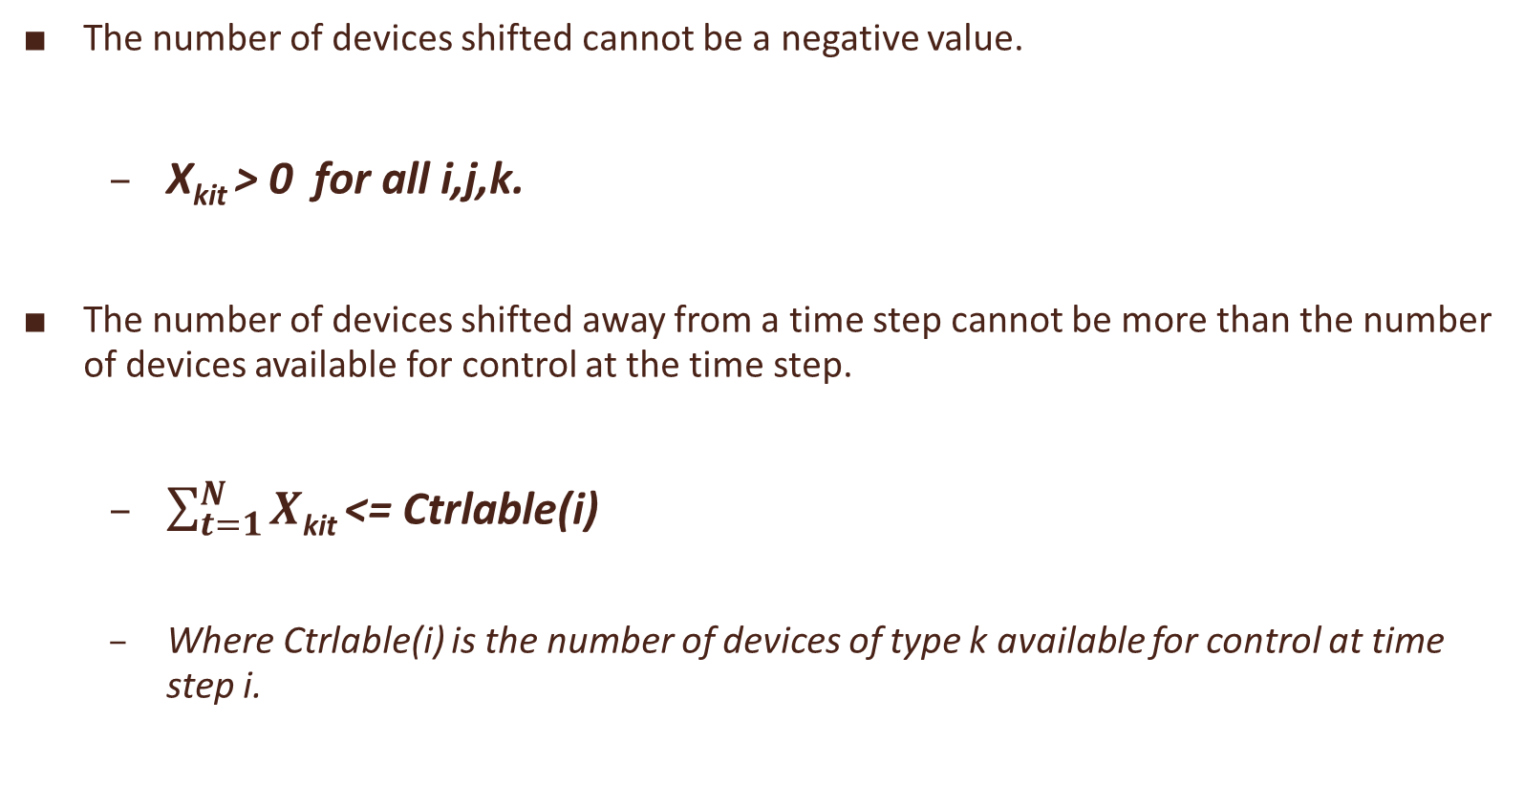
The number of devices shifted cannot be a negative value.
X_{kit} > 0 for all i,j,k.
The number of devices shifted away from a time step cannot be more than the number of devices available for control at the time step.
$\sum_{t=1}^{N}{X}$_{kit} <= Ctrlable(i)
Where Ctrlable(i) is the number of devices of type k available for control at time step i.

Slide 12
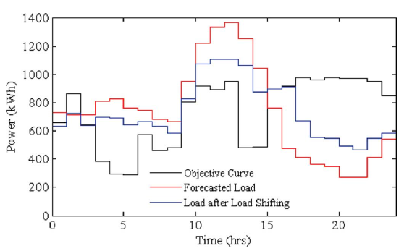
Expected Outcome

Slide 13
Tool : Genetic algorithm
The genetic algorithm is a method for solving both constrained and unconstrained optimization problems that is based on natural selection, that drives biological evolution.
The genetic algorithm differs from a classical, derivative-based, optimization algorithm in two main ways
CLASSICAL ALGORITHM | GENETIC ALGORITHM
1.Generates a single point at each iteration. The sequence of points approaches an optimal solution. 2.Selects the next point in the sequence by a deterministic computation | 1.Generates a population of points at each iteration. The best point in the population approaches an optimal solution. 2.Selects the next population by computation which uses random number generators

Slide 14
The Process Flow
In the genetic algorithm process is as follows:
Step 1. Determine the number of chromosomes, generation, and mutation rate and crossover rate value
Step 2. Generate chromosome-chromosome number of the population, and the initialization value of the genes chromosome-chromosome with a random value
Step 3. Process steps 4-7 until the number of generations is met
Step 4. Evaluation of fitness value of chromosomes by calculating objective function
Step 5. Chromosomes selection
Step 5. Crossover
Step 6. Mutation
Step 7. New Chromosomes (Offspring)
Step 8. Solution (Best Chromosomes)

Slide 15
Initialization
The most common type of genetic algorithm works as follows
A population is created with a group of individuals created randomly.
The random no generation is possible with rand() function.
The population is initialized keeping in account the constraints of the given problem.
Chromosome is initialized based on the constraints with the help of following logic
chromosome(I,j)=∑_(i=1)^n ∑_(j=1)^k (A(j)+(B(j)-A(j))*rand())
NOTE: rand() generates values between 0 and 1

Slide 16

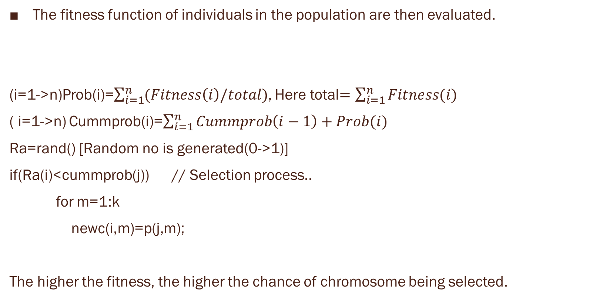
Evaluation and Selection…
The fitness function of individuals in the population are then evaluated.
(i=1->n)Prob(i)=$\sum_{i=1}^{n}{(Fitness\left(i\right)/total)}$, Here total$=\sum_{i=1}^{n}{Fitness(i)}$
( i=1->n) Cummprob(i)=$\sum_{i=1}^{n}{Cummprob\left(i−1\right)+Prob(i)}$
Ra=rand() [Random no is generated(0->1)]
if(Ra(i)<cummprob(j)) // Selection process..
for m=1:k
newc(i,m)=p(j,m);
The higher the fitness, the higher the chance of chromosome being selected.
n

Slide 17
Cross over
Three Steps involved in cross over
i).Parent Selection ii).N possibilities iii). Position for cross over
Step(i)
For k=1:n
R[k] ← random(0-1);
if (R[k] < ρc ) then
select Chromosome[k] as parent;
Step (ii):
For example: If three parents are selected then possibilities of crossover are,
Chromosome[1] >< Chromosome[4]
Chromosome[4] >< Chromosome[5]
Chromosome[5] >< Chromosome[1]
Step(iii)
m=floor((k-1)*rand()+1); (random no between 1 to (lengthofchromo-1)
for j=1:k
if(j<=m)
child(i,j)=parent(i,j);
else
child(i,j)=parent(i+1,j);
m points to position of crossover

Slide 18

Mutation
Total_gen(noe) = number_of_gen_in_Chromosome * number of population.
mut=pm*noe; where pm is the mutation rate.
totalmut=round(mut);
pos=floor((1+(noe-1)*rand(totalmut,1)));
The value of mutated gens at mutation point is replaced by random number.
for m=1:totalmut
if((i==row(m)) && (j==col(m)))
newc(i,j)=s(j)+(r(j)-s(j))*rand();
And after mutation process the next iteration starts and the process continues till we get the best chromosome…

Slide 19
Future Proceedings
In addition to the current work, solved as a single objective function, we add carbon footprint as a secondary objective together with DSM, treating it as a multi objective problem
E(t) = ECo2 x Pload(t)
Multi objective Problem = DSM (Primary Objective) + Co2 Footprint (Secondary Objective)
Solution to this Multi objective problem can be solved using NGSA II

Slide 20
Contribution to the Society:
Smartness: Effectively managing loads in a power grid by adopting intelligent DSM Controllers.
Smart Pricing: Automatic metering that allows consumers to make informed decisions regarding their energy consumption, and peak load pricing.
Virtual Power Plant: Voluntarily lowering consumers demand for electricity
Carbon Footprint: Reduced greenhouse gas emissions.

Slide 21
References:
[1] Nandkishor Kinhekar and Narayana Prasad Padhy, “Utility Oriented Demand Side Management Using Smart AC and Micro DC Grid Cooperative”, Year: 2015, Volume: PP, Issue: 99 Pages: 1 – 10.
[2] Thillainathan Logenthiran and Dipti Srinivasan, “Demand Side Management in Smart Grid Using Heuristic Optimization”, Year: 2012, Volume: 3, Issue: 3 Pages: 1244 – 1252.
[1] Q. Li and M. Zhou, “The future-oriented grid-smart grid,” J. Comput.,vol. 6, no. 1, pp. 98–105, 2011.
[2] P. Agrawal, “Overview of DOE microgrid activities,” in Proc. Symp. Microgrid,Montreal,QC, Canada, 2006 [Online].Available: http://der.lbl.gov/2006microgrids_files/USA/Presentation_7_Part1_Poonumgrawal.pdf
[3] S. Rahman and Rinaldy, “An efficient load model for analyzing demand side management impacts,” IEEE Trans. Power Syst., vol. 8, no.3, pp. 1219–1226, Aug. 1993.
[4] A. I. Cohen and C. C. Wang, “An optimization method for load management scheduling,” IEEE Trans. Power Syst., vol. 3, no. 2, pp.612–618, May 1988.
[5] K.-H. Ng and G. B. Sheblé, “Direct load control-A profit-based load management using linear programming,” IEEE Trans. Power Syst., vol. 13, no. 2, pp. 688–694, May 1998.
[6] F. C. Schweppe, B. Daryanian, and R. D. Tabors, “Algorithms for a spot price responding residential load controller,” IEEE Trans. Power Syst., vol. 4, no. 2, pp. 507–516, May 1989.

Slide 22
Thank You !!

